Slide 1
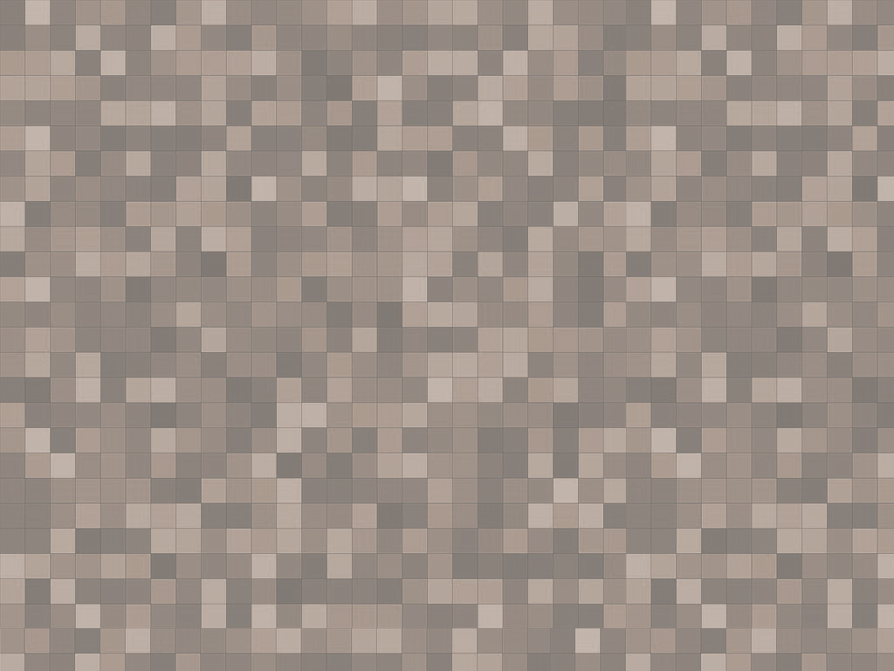
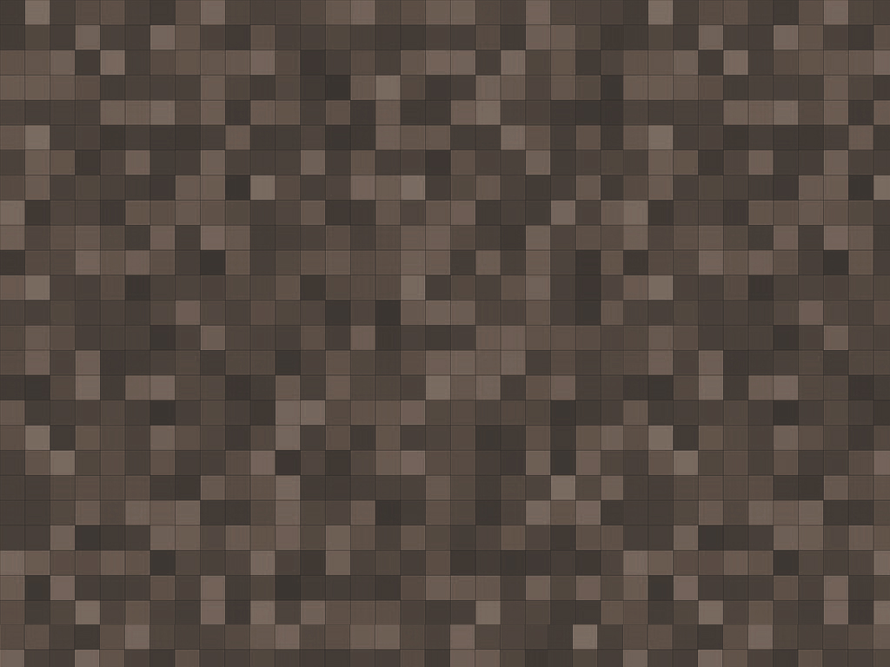
StalinRun
Working Title

Slide 2
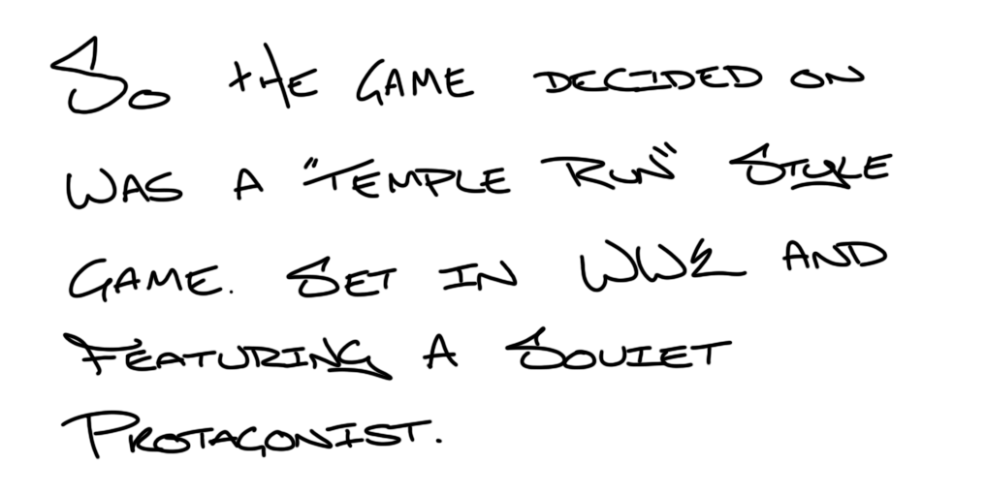
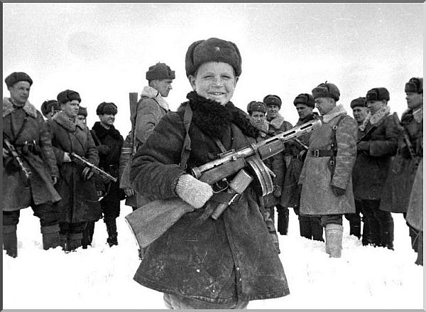
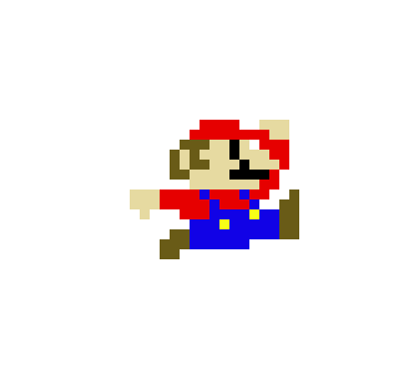
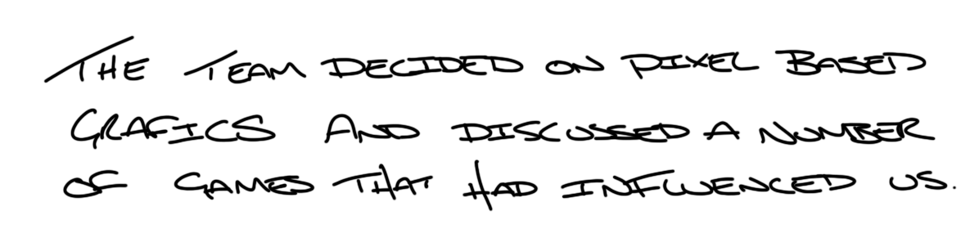
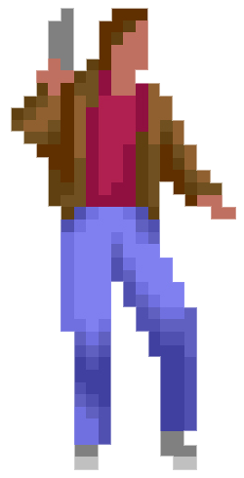

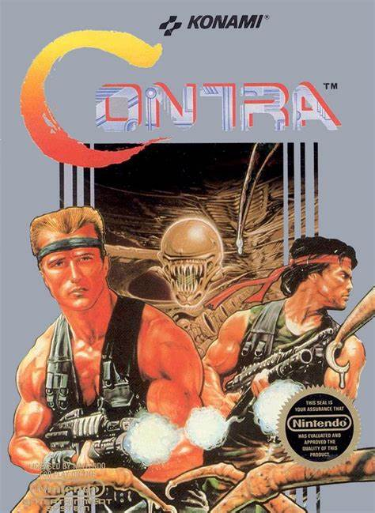
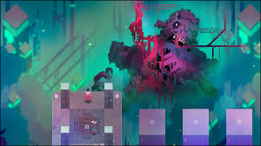
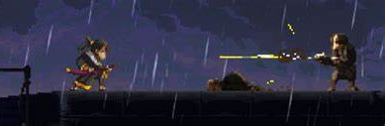
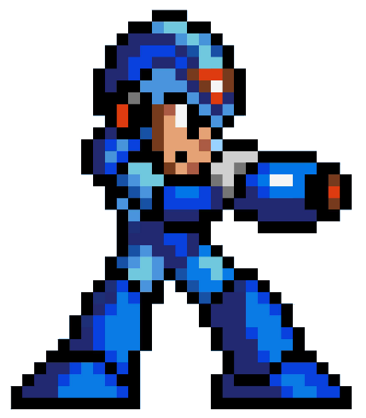
Hyperlight Drifter
Katana Zero

Slide 3
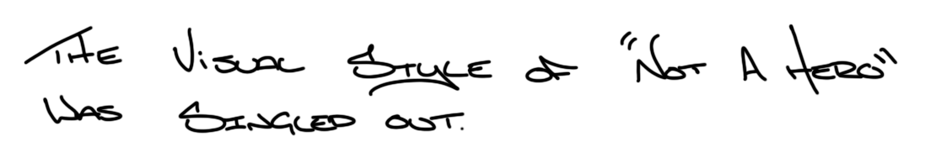
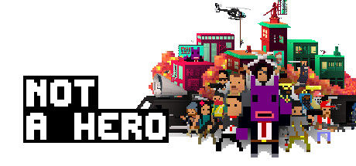
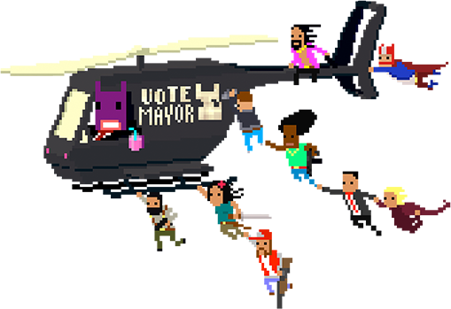
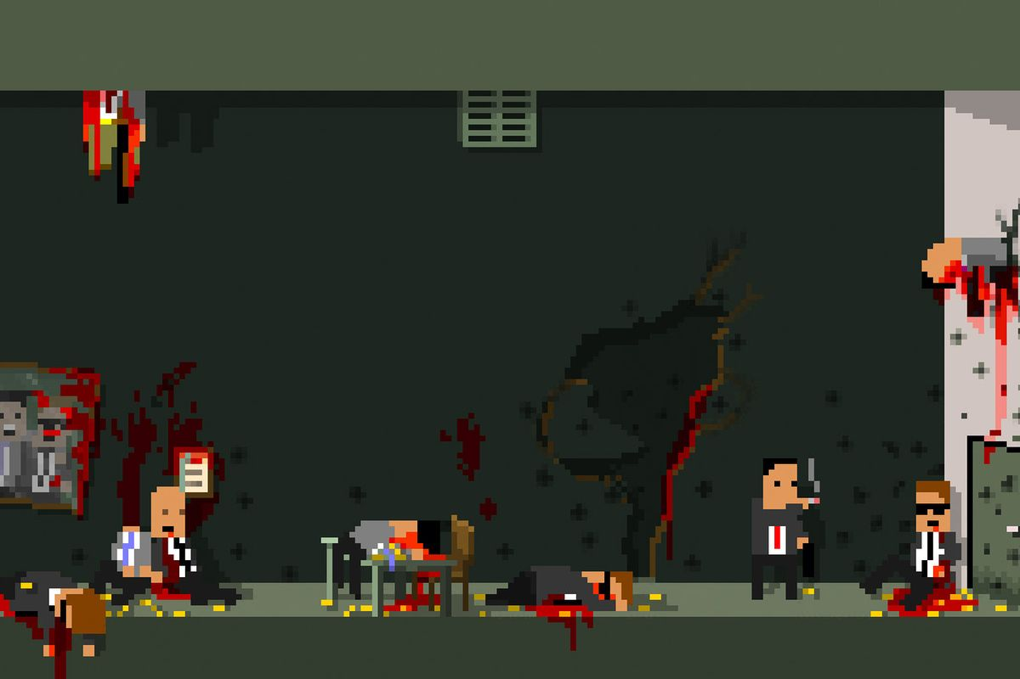
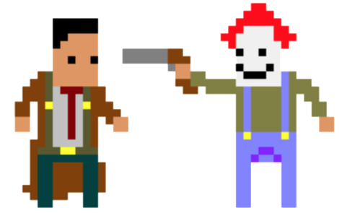
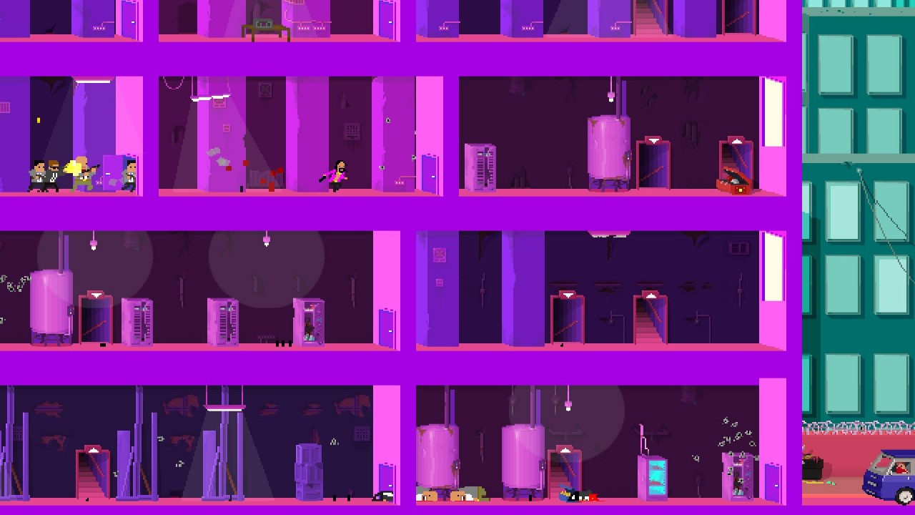
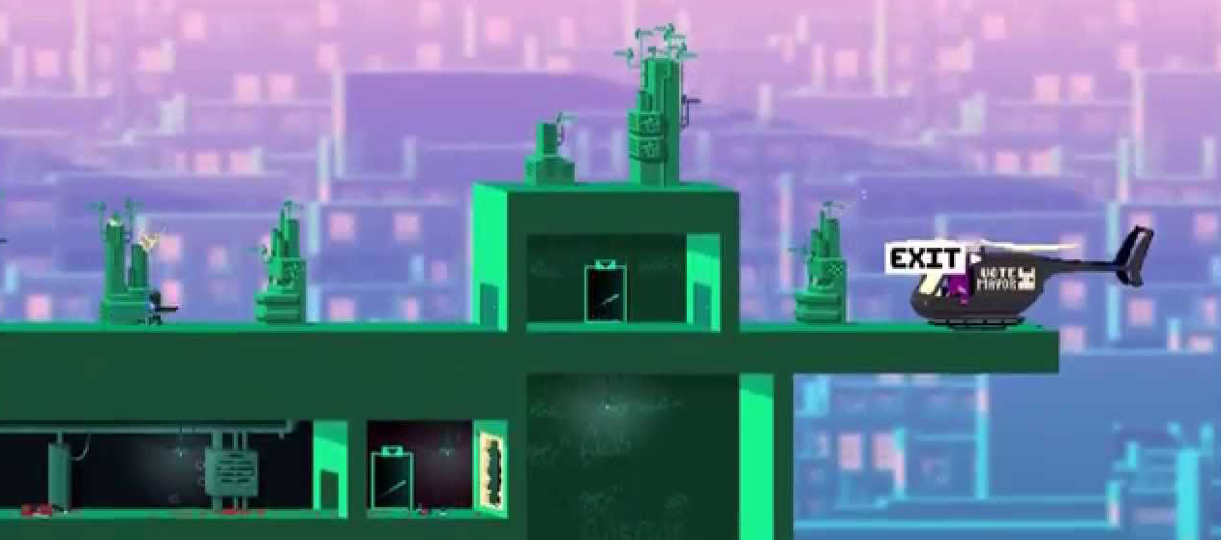
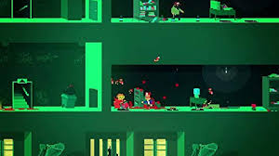
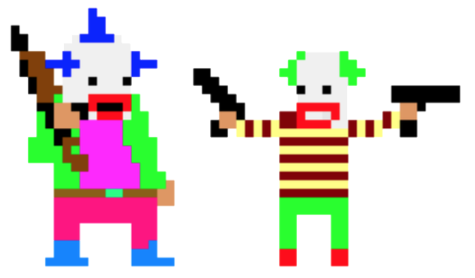
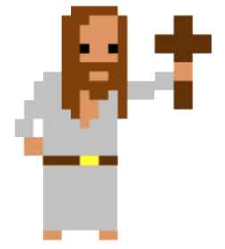

Slide 4
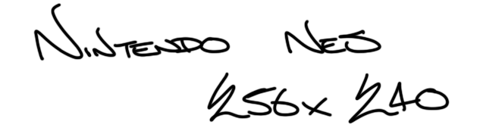
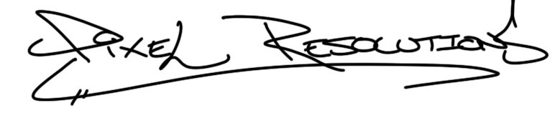
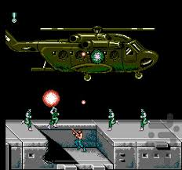
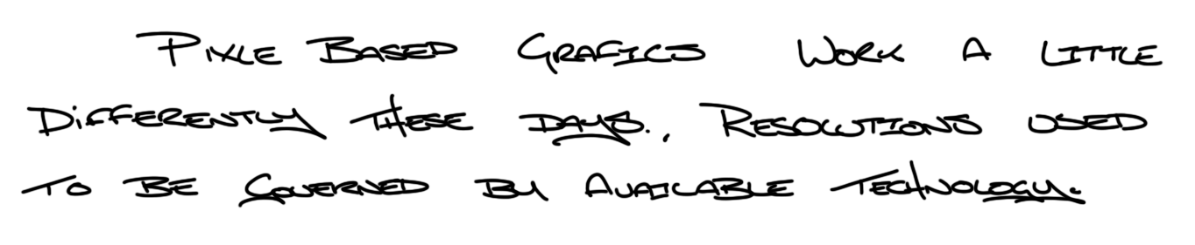
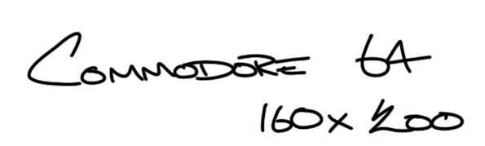
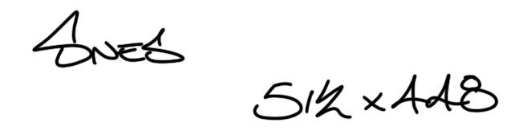
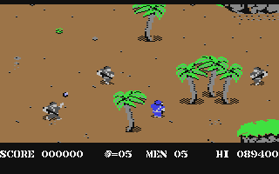
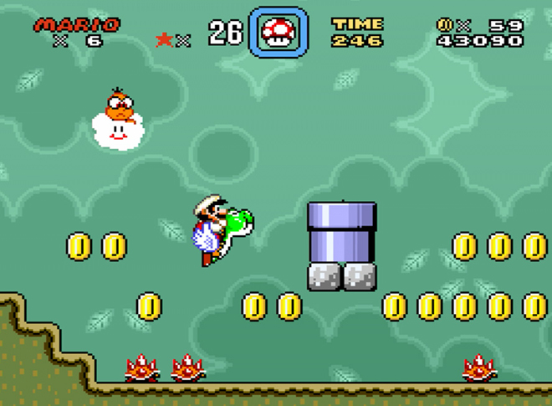
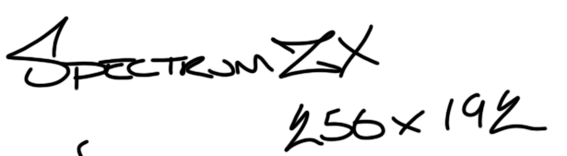
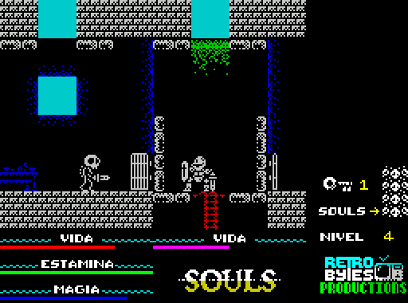
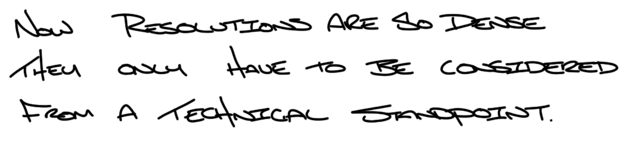
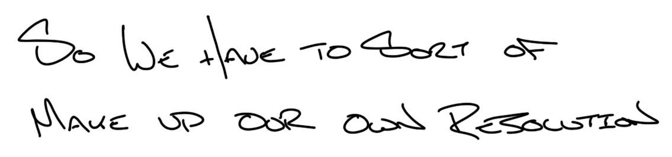

Slide 5
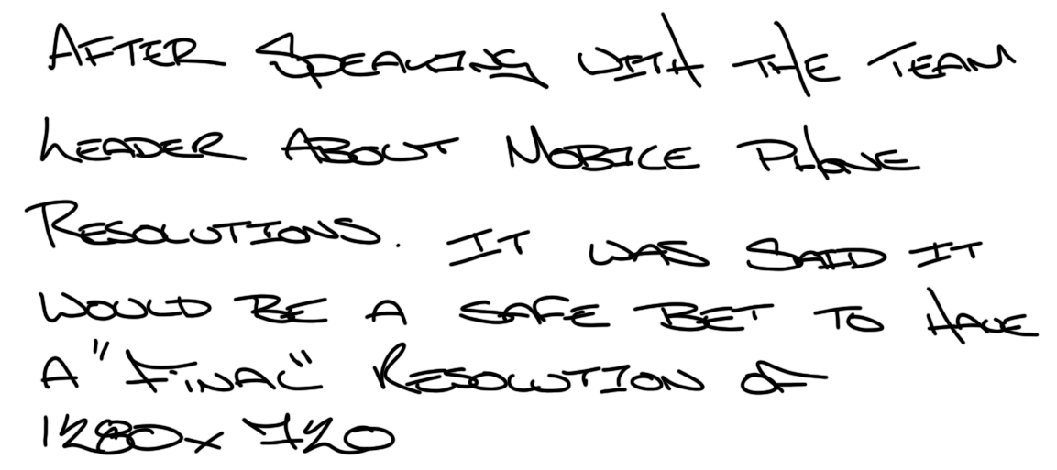
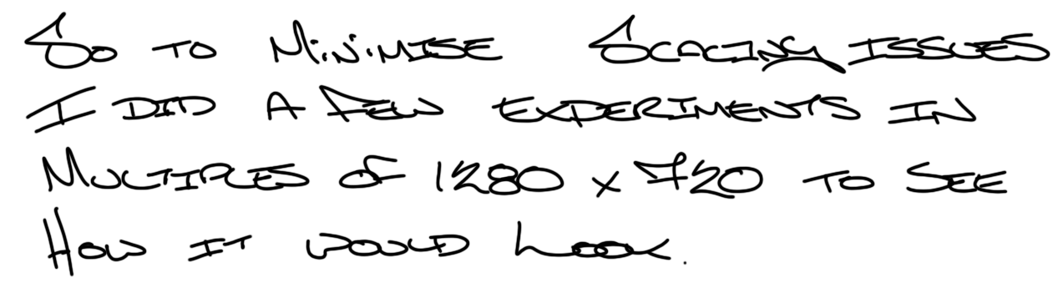
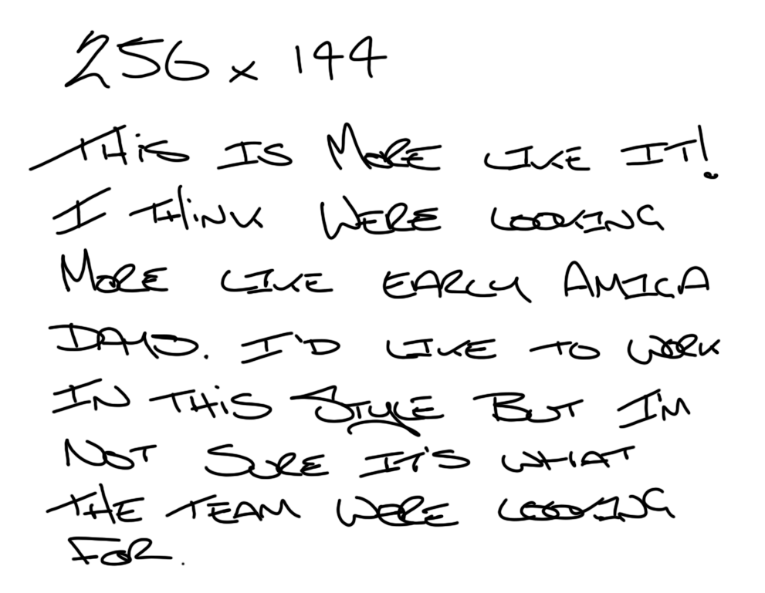
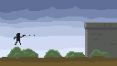
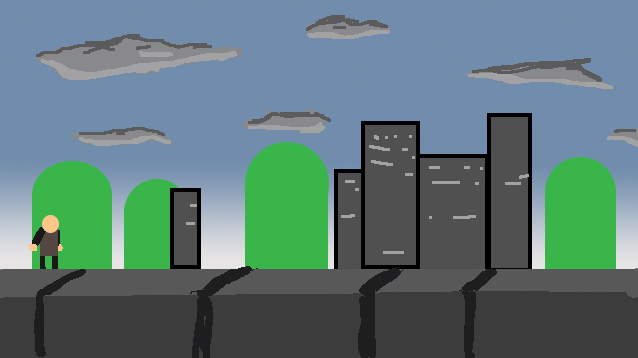
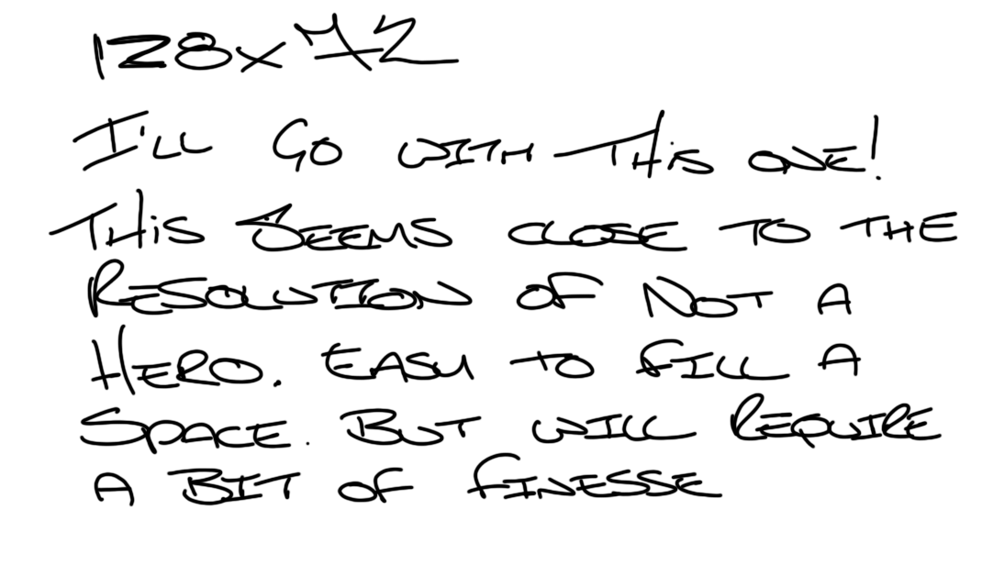
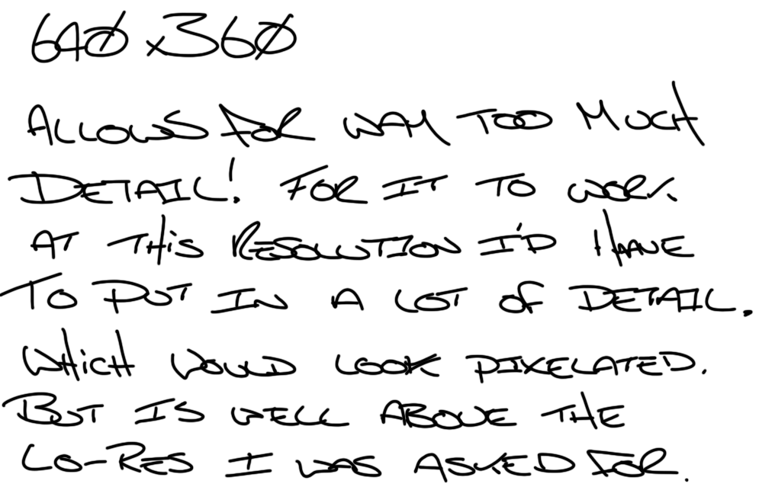
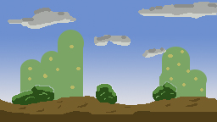
Resolution not Revolution

Slide 6
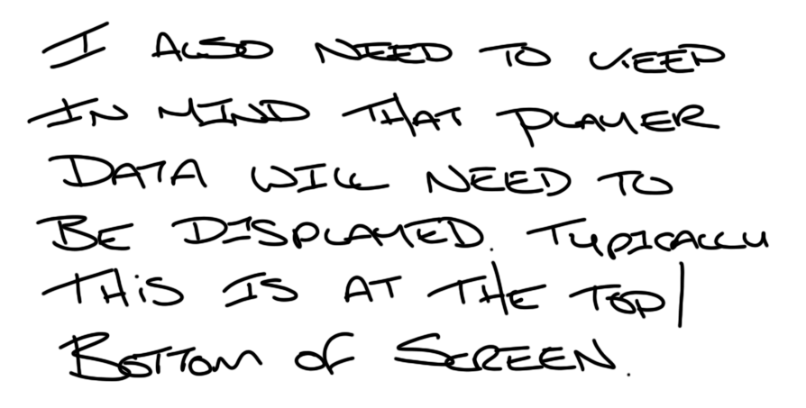
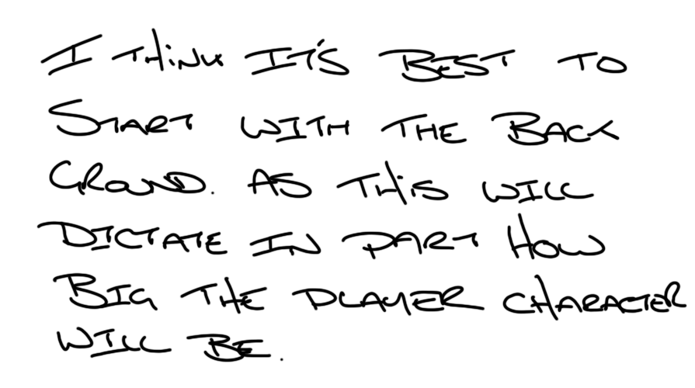
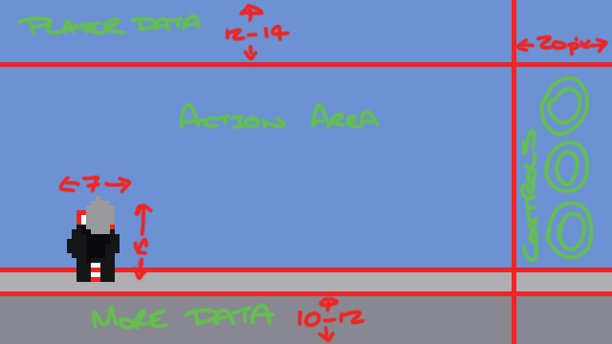
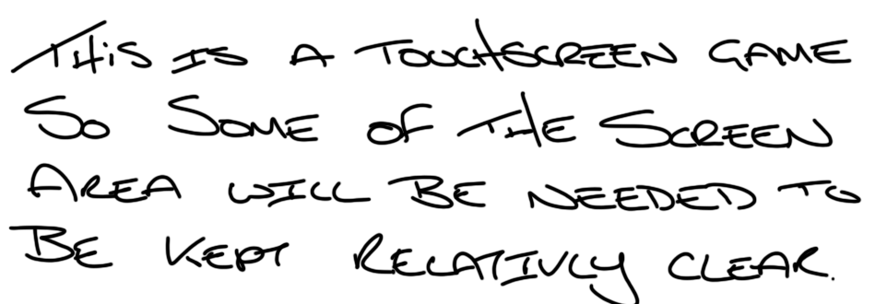
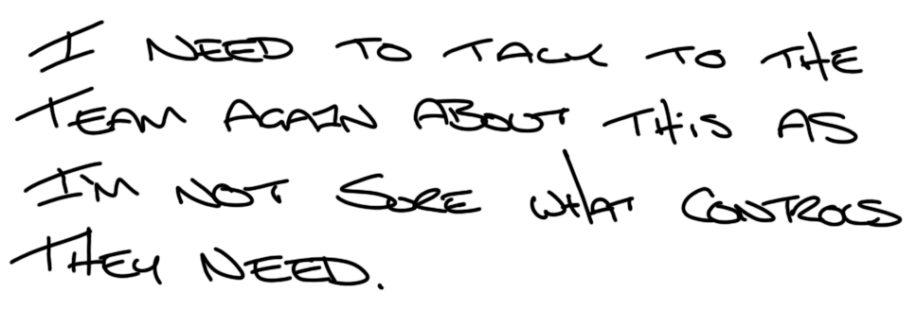
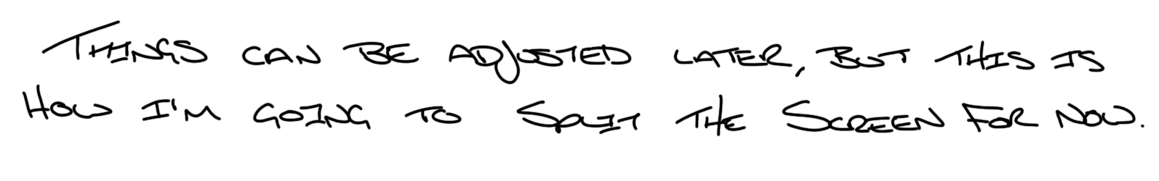
Back 2 Front

Slide 7
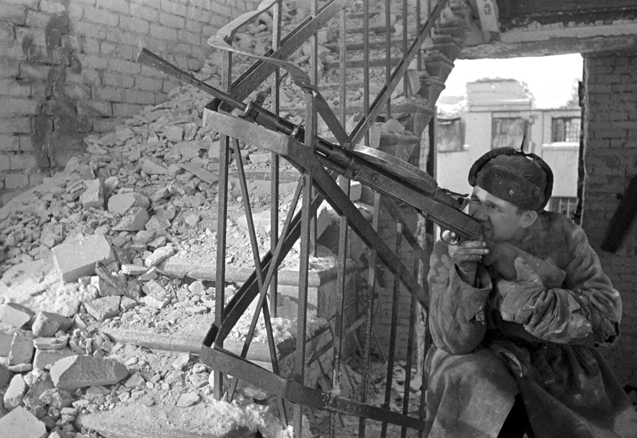
Background
Artist
This is just a sample of the photos I went through to make sure I get the right feel for the game. I’m not sure what the plans are in terms of how many levels and the environments they’re in. Plus it#s worth getting sensible ideas from background features.
Czech Hedgehog
Wood
Roads
Plane Wreck
Metal Debris
Smoke
Rocks
Fences
Ruined Buildings
Ruined Buildings
Fences
Barbed Wire
Bodies
Tires
Train Tracks
Rocks/Debris
I really like the idea of including this downed plane, but I’ll sit on this because it could be used as a special background for an event or boss battle

Slide 8
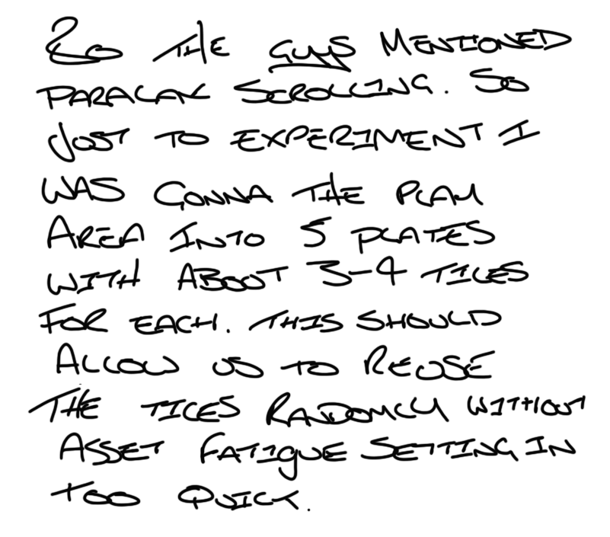
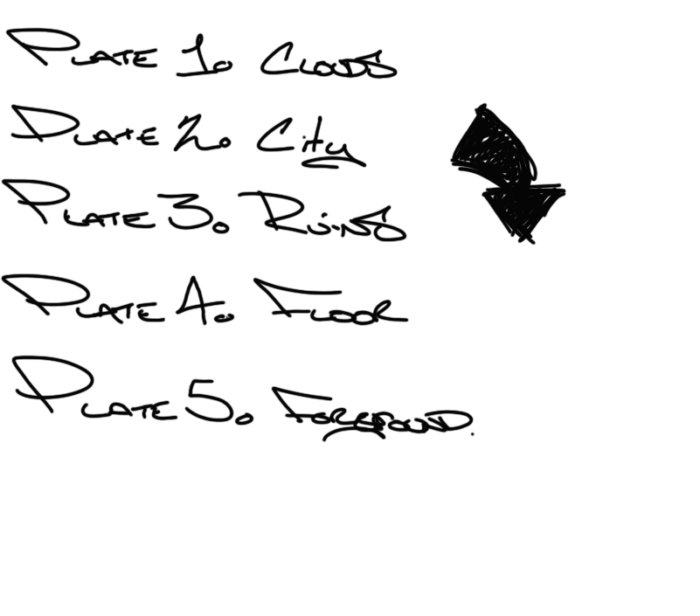





The Parallax
View
Background 1st Draft
Background 1st Draft
This isn’t the final draft. As I’m not happy with some of the elements. This is just to show the team to get an okay on.

Slide 9

The
Pixelated
Man
Character Design Template Drafts
Character Design Template Drafts
I think a few of the team member wanna have a crack a designing things, plus I’m gonna need to know approximate sizes so that everything is of a uniform size.
If we have a template to guide our designs, this should minimise the amount of adjusting later on to make sure everything fits.
Quick doodle to find out how much space the character should take up on screen it looks like around 15px tall should work. Width isn’t too much of a problem as we have more space in that direction
So the size is okay here, but this is not gonna allow for that much detail or animation.
I thought I’d go bigger, just to see. But these look like giants on the battlefield when I placed them in the scene to test. But these are a good base to scale back down from.
This is getting there, but still looks a touch to big. One more shave should do it.
So this is the one I’m gonna submit to the team. I think it’s going to allow for enough detail to distinguish characters apart. Also it should allow for some deformations. Such as a heavier set guy, with a beard, square chin. Could probably mess around with the eyes as well. Plenty I’d like to experiment with.

Slide 10







Player Character
I did a quick second player just to demonstrate to the team that the template is a guide and that you can “Colour outside the lines” as it were. The guys were quite positive about including a Ushanka. So I’ve used that and a cape to display the versatility of the template.
Player Character
I’ll probably give the characters another pass when we’re all settled in what we’re building.
I just wanted to knock out a couple of characters to show the team how it would work.
I’ll be adding in weapons and animation sprites when I know a bit more of what’s planned for the game.
Character Updated: Full sprite sheet created
I was thinking about keeping a little flash of bright red on the player characters. So that the user has something visual to zero in on if they lose sight of the character in the chaos.
Player Character
2
Player Character

Slide 11

















Bits
‘n’
Pieces
Level 1: Stalingrad
Level 1: Stalingrad
Farground Plates
Background Plates
Floor Plates
Platform Plates
Foreground Plates
Sky Plates
Platform Plates
Foreground Plates
Farground Plates
Background Plates
Floor Plates

Slide 12

This is the kinda thing you can make with the tileset. With a bit of parallax scrolling it should look alright. This means Viktor and the team should be able to design the levels as they go.
Example\Test
Example\Test
The white specks around the trenches and are a mistake. Corrected version in files
The colours are melting together. I can change them later, on maybe the guys can change in unity.
I need to add some variance in the height of the ruins. It’s a bit much.
May need another plate for each set.

Slide 13


Sprite Sheet Template
Sprite Sheet Template
Idle
When creating a character, as long as all these sprites are covered. It should be fully functional.
Run Cycle Right
Run Cycle Left
Jump Frames Left/Right
Slide Frames Left/Right
I’d like to get an idle animation in at some point. Maybe a simple turn as well. Even if it’s just the eyes leading the turn.
For Characters with guns, adjust accordingly

Slide 14














Spritely
Spritely
Sprites
I’ve only included the right facing sprites here, as at the moment the player is only travelling in one direction. The sprites only need to be duplicated and flipped if that changes.
Idle
The highlighted are the “hold” sprites. These are the sprites you hold on for the duration of the action performed. Jump has two. Frame 2 for ascending in the jump. The other for descending. You should just be able to slip straight back into Frame 1 of the walk cycle from any of the other ending sprites.
Jump Frames Right
Run Cycle Frames 1-4 are identical to Frames 5-8. It was just easier to work in 8 frames and I forgot to delete the last 4.
Also, That walk cycle is gonna need a test. I’ve a feeling that it’s gonna look a little weird.
Slide Frames Right
Run Cycle Right

Slide 15



Seige
of
Stalingrad
Press Start 2p
So this is also the typeface I’ve been using for this production diary. I just thought it just fitted with the pixel aesthetic without me having to create it myself. Also after talking to the team. They said unity handles TrueType fonts well and it would be easier for them to use. I thought this would be best for all non title copy.
The team have decided on a name. The colour pallet I’ve been using, and the name kinda made me thought of those old movies from the 40’s and 50’s. So I thought I’d make the splash screen take on that sorta look. I’m not generally a fan of royalty free typefaces, because they are mainly geared towards adaptions of unique typefaces for films and games. However that’s the kinda look I’m after so it’s quite useful here.
Above is a typeface called The Incredibles. A rip from the movie of the same name which also had a similar old school art deco look. Below is Adventurer, that is obviously taken from the Indiana Jones franchise. This also was looking at the matinee films of the era.

Slide 16






I’m going with this design for now as the title screen. I’d like to do an animation over the top which would replicate the scratches and pops on old film stock. But I get the feeling that it would be a bit of extra work that’s not needed.
The Ushanka head needs updating. And I think the heads need to be in a proper box to separate them from the background. Also im not sure the red highlight box is needed as it’s a touch screen game. You only really need it for controllers ect.
The guys have said they pretty much have everything they need from me to make the game. So I’m not sure what else to do. So I’m just making it up now and I’m gonna wait and see how much of it makes it’s way in.
So I don’t think a character selection screen is needed. But I’ve done one because I quite like the other comrade.

Slide 17















&
life
Death
I said I do a bunch of health bar type designs, and they could choose which one. I was pleased with how my pixel Lenin worked out, but I think it’s a bit inappropriate. My favourite was the flag that drooped slightly with every hit. But the five point start was chosen. I’ll do a few more variations of those before we pick a final.
I thought having a little grave bounce along after the player has died, would be a good way to fail.
Or whatever character is being played they could turn into a statue. Those communist states do love a statue
Or he could turn into a skeleton Ghost ‘n’ Ghouls style. The hat is the identifying feature so I thought that could be kept but a final bounce on the ground.
Health Star variants pushed

Slide 18






















Death
Nazi
of a
I think that there needs to be some sort of visual reward for a kill. A nice animation in simple games makes every “kill” seem like a mini achievement. Miyhar is working on the bad guys generally. So I’m leaving that to him, but I did want to have a go at animating a death. And if it’s liked maybe it could be incorporated into his designs. So this is a quick work up of a gerneric bad guy. Getting blown away.

